Slide 1
ICT 001 class activity

Slide 2
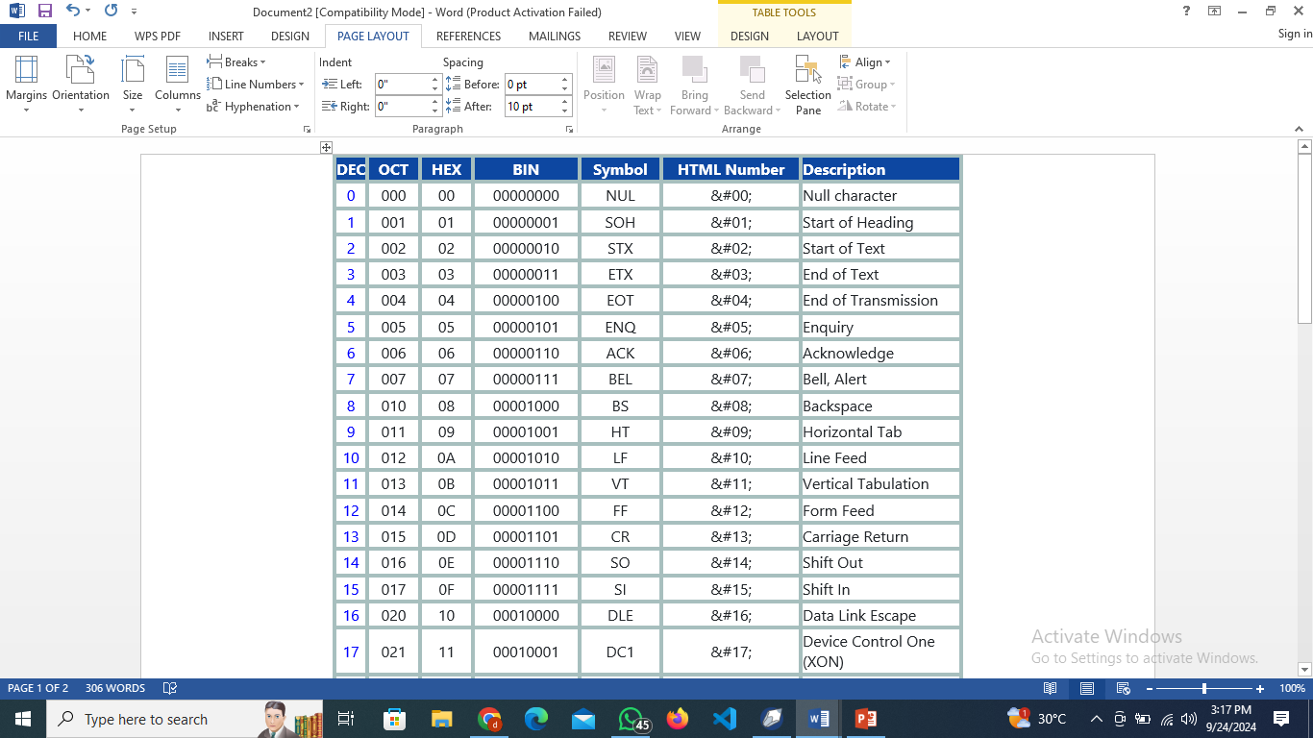
Study this ASCII table

Slide 3
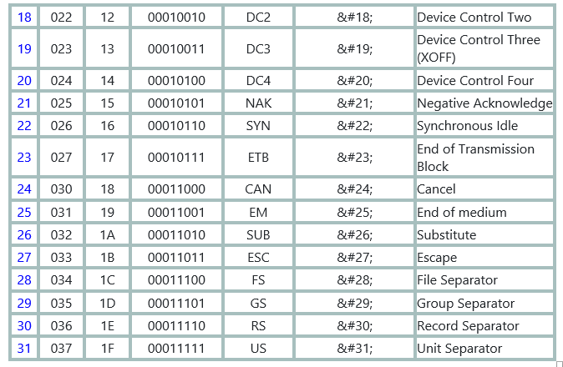

Slide 4
Do this in your note (task one)
Look at the ASCII code table very well and write the below sentence in full
MR JUDE IS making 00000101 about VT, OD and 07 fortunately, all customer service rep has $#27 and not even anyone to 00011011 with so all mr jude effort is $#24.

Slide 5
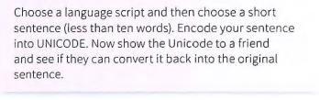
Do this in your note (task two)

Slide 6
Thanks see you next class

